Slide 1
Graph Neural Differential Equations lecture-11 Course on Graph Neural Networks (Winter Term 20/21)
Christian Medeiros Adriano (christian.adriano@hpi.de) - “Chris”
Sona Ghahremani (sona.ghahremani@hpi.de )
Prof. Dr. Holger Giese (holger.giese@hpi.de)

Slide 2
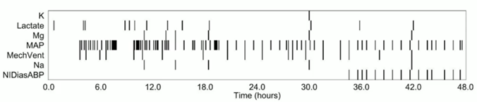
Beyond Continuous Time
Observational data
do not arrive at regular time steps
comprise of different types
emerge from various data generation processes (not only Gaussian)
Examples
News Comments
Traffic
Patient data
Example of irregularly sample data from patients
Source: [Rubanova, et al. 2019]
Rubanova, Y., Chen, T. Q., and Duvenaud, D. K. (2019). Latent ordinary differential equations for irregularly-sampled time series. NeurIPS.
Notes:
[46] Rubanova, Y., Chen, T. Q., and Duvenaud, D. K. (2019). Latent ordinary differential equations
for irregularly-sampled time series. In Advances in Neural Information Processing Systems, pages
5321–5331.

Slide 3
Key Benefits [Poli et al 2019]
Continuous time-series models:
No need to discretize time (binning) as in RNNs
Allow irregular sampled data without need to input missing data
Memory Efficient: Fixed cost regardless of the depth of the network
Adaptive computation:
Bounded growth of approximation error by using ODE solvers to monitor error level and adapt the evaluation strategy according to the desired level of accuracy
Cost evaluation model scales with problem complexity, for instance, reduce accuracy requirements in real-time and low-power applications
Parameter efficiency: fewer parameters for a supervised task, because the hidden unit dynamics are continuous function of time that connect the nearby “layers” automatically together.
Scalable and invertible normalizing flows: Easier to compute changes in the variable formula
Poli et al., (2018) Neural Ordinary Differential Equations, NeurIPS.

Slide 4
High-Dimensional Time Series Models
h_{t}
h₀
h₁
h_{t}
Recurrent Neural Networks
A
A
A
A
x_{t}
x_{o}
x₁
x_{t}
Hidden Markov Models
Hidden states Z
Observations X
Emission probabilities p(X|Z)
Z₁
Z₂
Z_{t}
All these models require discrete time
x₁
x₂
x_{t}
Deep Markov Models
Uses complex multi-layer perceptron to learn the emission and transition probabilities
Z₁
Z₂
Z_{t}
x₁
x₂
x_{t}
Krishnan, et al., (2017), Structured inference networks for nonlinear state space models, AAAI.
Notes:
Krishnan, Rahul, Uri Shalit, and David Sontag. "Structured inference networks for nonlinear state space models." Proceedings of the AAAI Conference on Artificial Intelligence. Vol. 31. No. 1. 2017.

Slide 5
Definition: Graph Neural Differential Equations (GDEs)
Graph neural ordinary differential equations (GDEs): are GNNs with the input–output relationship determined by a continuum of GNN layers, blending discrete topological structures and differential equations.
Why do we need Graph Neural Differential Equation?
in static settings: easier computation by incorporating numerical methods in their forward pass
in dynamic settings: better performance by exploiting the geometry of the underlying dynamics.
i.e., GDE’s generalize models that are static (convolutional) and dynamic (temporal, time series, auto-regressive)

Slide 6
Quick recap – Where are we now?
Graph Metrics and Random Models
Graph Classification - Clustering
Graph Sampling - Random Walks
Graph Embeddings - Message Passing
PageRank
Graph Structure Learning
Graph Convolutional Networks
Graph Attention Networks
Graph Evolution Networks
Temporal Graph Networks
Graph Neural Differential Equations
Deep Graph Generative Models
Causal Inference on Graph Neural Networks
Network Effects, Cascading and Contagion
Outbreak Detection in Networks
Influence Maximization in Networks
Design concerns
Understand a phenomenon
Extract features
Stablish baselines
Preprocess data
Description models
Predict an outcome
ML architecture and pipeline
Training models
Evaluation models
Prediction models
Effects of interventions
Risks of confounding
Causal structure
Intervention models
Notes:
[Wang & Tax 2016] Wang, Feng, and David MJ Tax. "Survey on the attention based RNN model and its applications in computer vision." arXiv preprint arXiv:1601.06823 (2016).
[Luong et al. 2015] Luong, Minh-Thang, Hieu Pham, and Christopher D. Manning. "Effective approaches to attention-based neural machine translation." arXiv preprint arXiv:1508.04025 (2015).
[Vaswani et al. 2017] Vaswani, A., Shazeer, N., Parmar, N., Uszkoreit, J., Jones, L., Gomez, A. N., ... & Polosukhin, I. (2017). Attention is all you need. Advances in neural information processing systems, 30, 5998-6008.
Bahdanau, Dzmitry, Kyunghyun Cho, and Yoshua Bengio. "Neural machine translation by jointly learning to align and translate." arXiv preprint arXiv:1409.0473 (2014).
Xu, Kelvin, et al. "Show, attend and tell: Neural image caption generation with visual attention." International conference on machine learning. 2015.
The research described in the paper Graph Convolutional Network (GCN), indicates that combining local graph structure and node-level features produces good performance on node classification tasks. However, the way GCN aggregates is structure-dependent, which can hurt its generalizability.
One workaround is to simply average over all neighbor node features as described in the research paper GraphSAGE. However, Graph Attention Network proposes a different type of aggregation. GAN uses weighting neighbor features with feature dependent and structure-free normalization, in the style of attention.

Slide 7


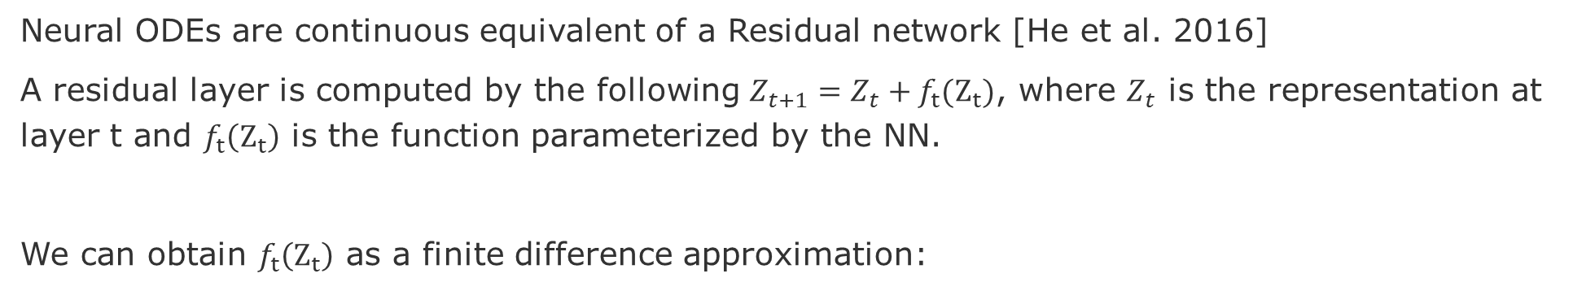
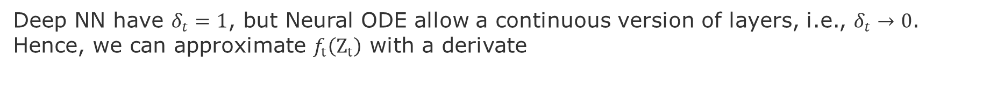
Definitions of Neural ODEs
Neural ODEs are continuous equivalent of a Residual network [He et al. 2016]
A residual layer is computed by the following $Z_{t+1}=Z_{t}+f_{t}(Z_{t})$, where $Z_{t}$ is the representation at layer t and $f_{t}\left(Z_{t}\right)$ is the function parameterized by the NN.
We can obtain $f_{t}\left(Z_{t}\right)$ as a finite difference approximation:
Deep NN have $δ_{t}=1$, but Neural ODE allow a continuous version of layers, i.e., $δ_{t}→0$. Hence, we can approximate $f_{t}\left(Z_{t}\right)$ with a derivate
Neural ODEs continuously evolve the representation $z(t)$ with time $t$.
But how?
He, K., et al., (2016). Deep residual learning for image recognition, CVPR, pp. 770-778.
Notes:
He, K., Zhang, X., Ren, S., and Sun, J. (2016). Deep residual learning for image recognition. In proceedings of the IEEE conference on computer vision and pattern recognition, pages 770–778.
The output dimension of $f_{t}(Z_{t})$ is the same as the input of dimension that allows it to be added to the features of the previous layer $Z_{t}$

Slide 8
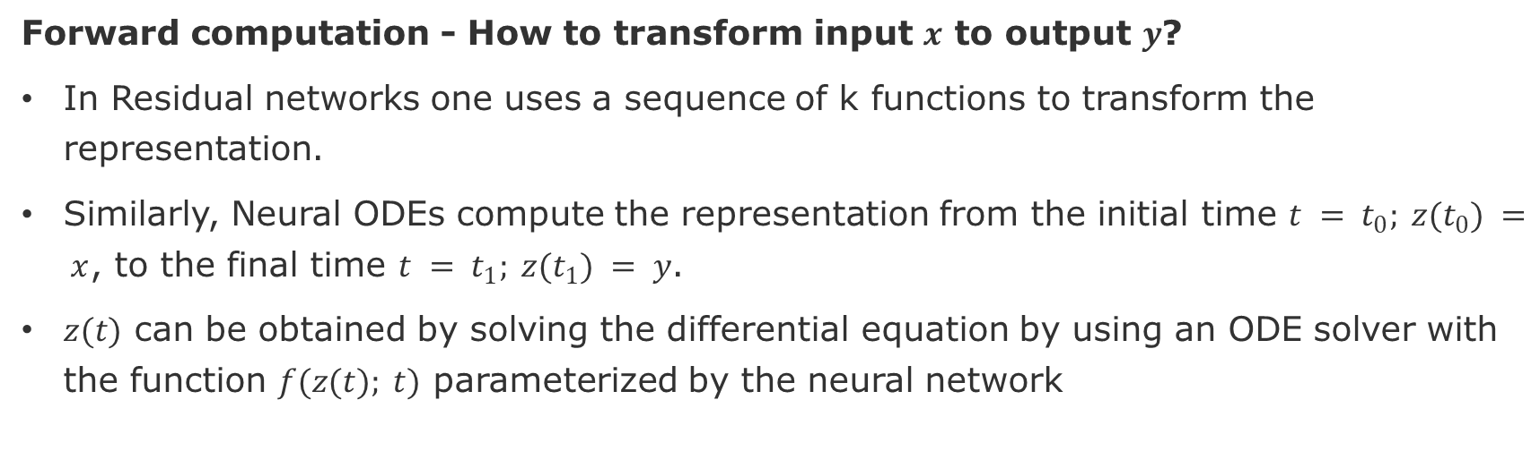
How do the Neural ODE work?
Residual network use shortcuts to jump over some layers to mitigate the vanishing gradient problem.
Forward computation - How to transform input $x$ to output $y$?
In Residual networks one uses a sequence of k functions to transform the representation.
Similarly, Neural ODEs compute the representation from the initial time $t = t_{0}; z(t_{0}) = x$, to the final time $t = t_{1}; z(t_{1}) = y$.
$z(t)$ can be obtained by solving the differential equation by using an ODE solver with the function $f(z(t); t)$ parameterized by the neural network
Backpropagation – How to update the parameters of the function $f_{t}(Z_{t})$ ?
The ODE solver provides the appropriate gradients so $Z_{t}≈y$to update the parameters of the function $f(z(t); t)$
Notes:
Residual neural networks use skip connections, or shortcuts to jump over some layers.
Skipping over layers helps avoid the problem of vanishing gradients, by reusing activations from a previous layer until the adjacent layer learns its weights.

Slide 9
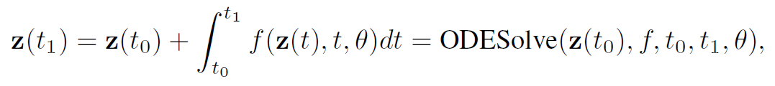
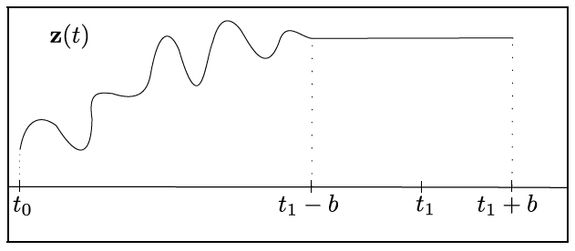
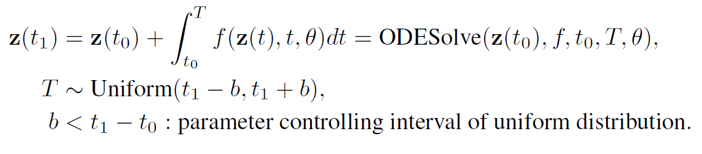
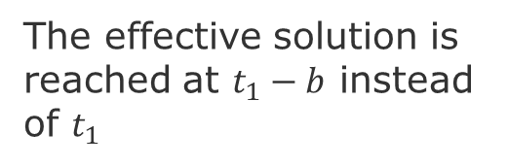
Time Regularization [Ghosh et al. 2020]
Standard Neural ODE is solved for the interval between $t_{0}$ and $t_{1}$
A simple regularization consists of disturbing the final time $t_{1}$by at each
training iteration, stochastically sample the integration:
The effective solution is reached at $t_{1}−b$ instead of $t_{1}$
Ghosh, A., et al., (2020) "STEER: Simple Temporal Regularization For Neural ODEs." arXiv preprint arXiv:2006.10711
Notes:
Ghosh, Arnab, et al., (2020) "STEER: Simple Temporal Regularization For Neural ODEs." arXiv preprint arXiv:2006.10711

Slide 10
How to update the network (backpropagation)?
Apply the adjoint sensitivity method [Pontryagin et al., 1962]
How it works?
computes gradients by solving a second, augmented ODE backwards in time
it is applicable to all ODE solvers.
Advantages:
scales linearly with problem size
has low memory cost
explicitly controls numerical error
Pontryagin, L., et al., (1962) The mathematical theory of optimal processes.
Notes:
Lev Semenovich Pontryagin, EF Mishchenko, VG Boltyanskii, and RV Gamkrelidze. The mathematical
theory of optimal processes. 1962.

Slide 11
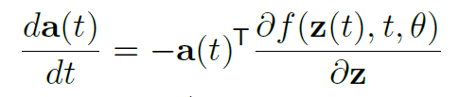
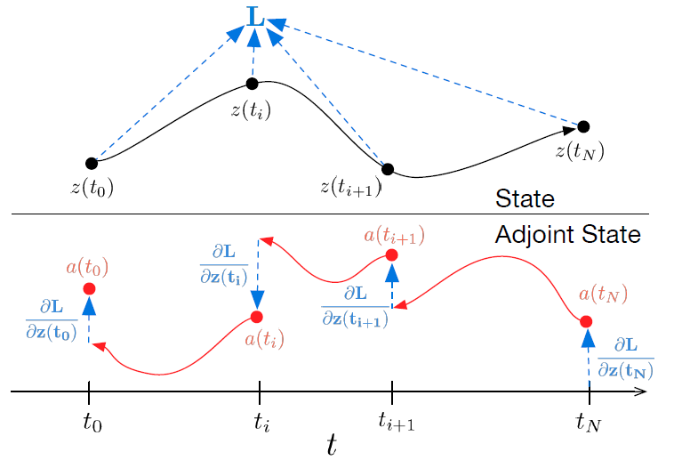
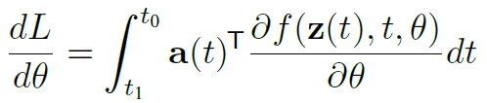
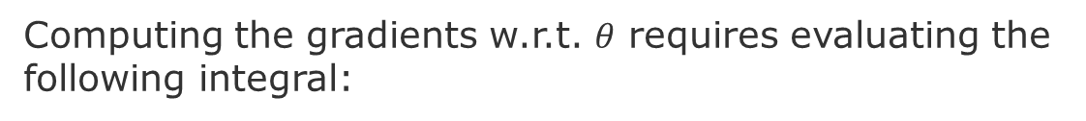
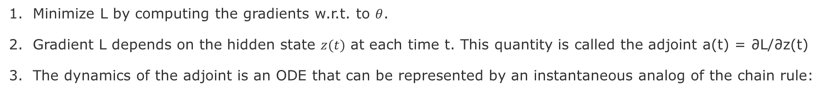
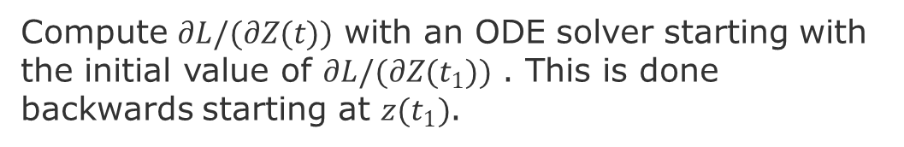
Loss Function L
Minimize L by computing the gradients w.r.t. to $θ$.
Gradient L depends on the hidden state $z(t)$ at each time t. This quantity is called the adjoint a(t) = ∂L/∂z(t)
The dynamics of the adjoint is an ODE that can be represented by an instantaneous analog of the chain rule:
Compute $∂L/(∂Z(t))$ with an ODE solver starting with the initial value of $∂L/(∂Z(t_{1}))$ . This is done backwards starting at $z(t_{1})$.
Computing the gradients w.r.t. $θ$ requires evaluating the following integral:
Notes:
The adjoint sensitivity method (Pontryagin et al., 1962)
computes gradients by solving a second, augmented ODE backwards in time, and is applicable to all ODE solvers.
scales linearly with problem size, has low memory cost, and explicitly controls numerical error

Slide 12
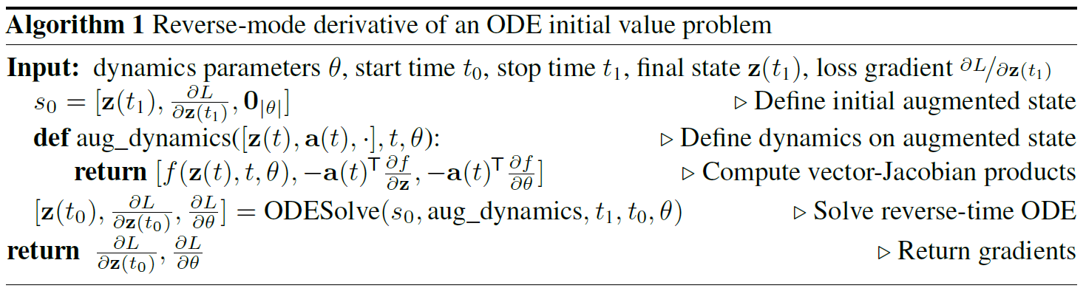
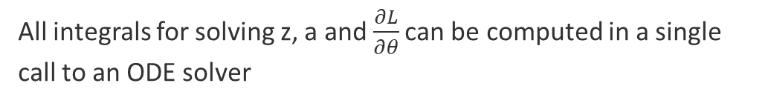
Algorithm for Backpropagation
The vector-Jacobian can be efficiently evaluated by automatic differentiation
All integrals for solving z, a and $\frac{∂L}{∂θ}$ can be computed in a single call to an ODE solver
Chen, et al., (2018) Neural Ordinary Differential Equations, NeurIPS.

Slide 13
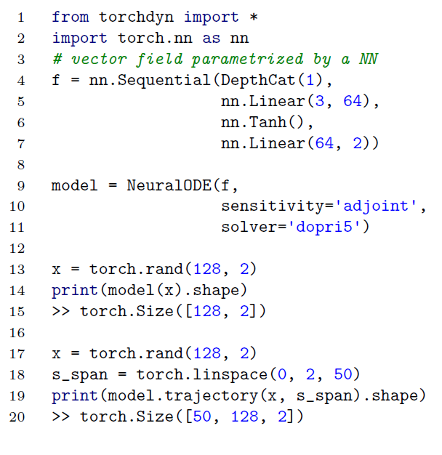
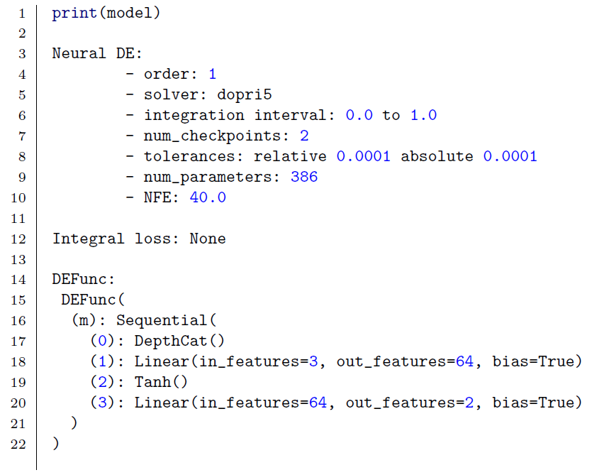
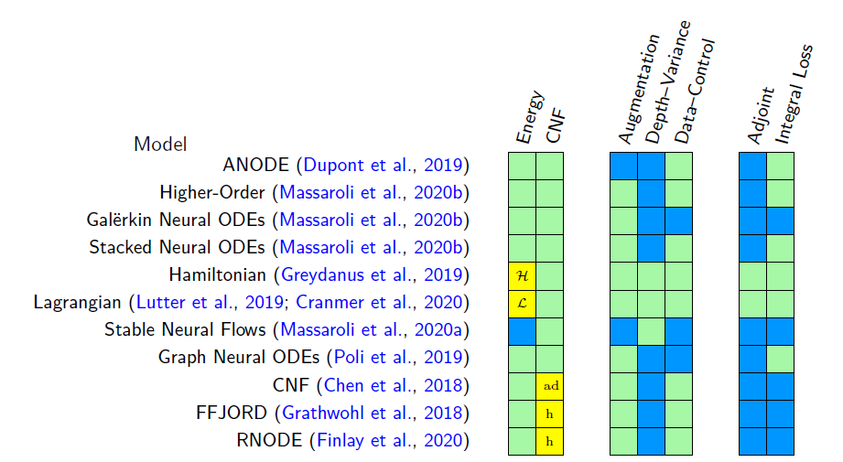
Library TorchDyn [Poli et al. 2020]
The Neural ODE can instance can be passed tensor data directly, implicitly utilizing the .forward.
Support in torchdyn of different SOTA models
Poli, et al., 2020, TorchDyn: A Neural Differential Equations Library

Slide 14
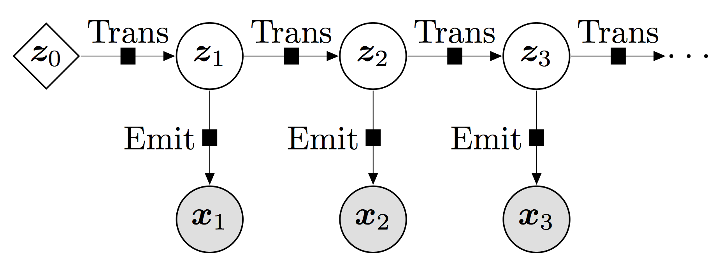
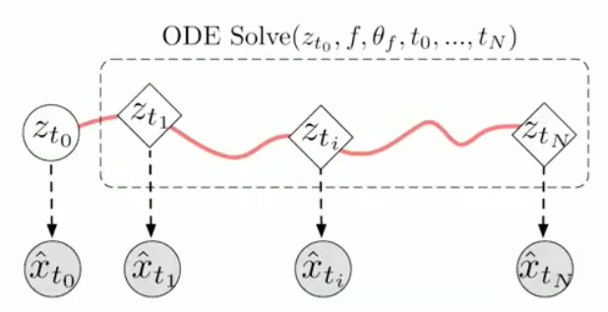
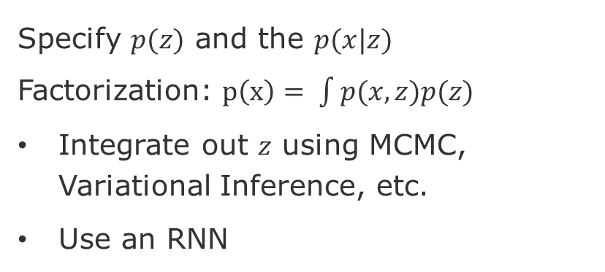
Latent Models with Neural ODEs
Specify $p(z)$ and the $p(x|z)$
Factorization: $p\left(x\right)= \int{p(x,z)p(z)}$
Integrate out $z$ using MCMC, Variational Inference, etc.
Use an RNN
source: https://pyro.ai/examples/dmm.html
Or model the internal states and their emission probabilities as a single Ordinary Differential Equation

Slide 15
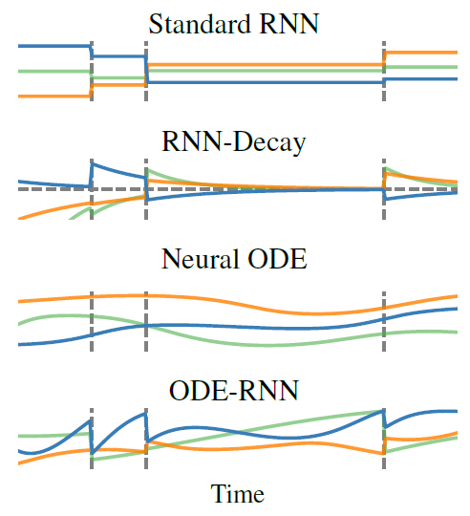
Comparing Different Hidden States Trajectories
Lines represent different dimensions of the hidden states
States are constant or undefined between observations
States which exponentially decay towards zero
States follow a complex trajectory,
but are still determined by the initial state
Sates that follow an ODE between observations,
but are updated at each new observation
Rubanova, et al., (2019) Latent ordinary differential equations for irregularly-sampled time series, NeurIPS

Slide 16
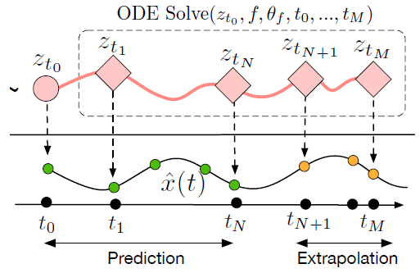
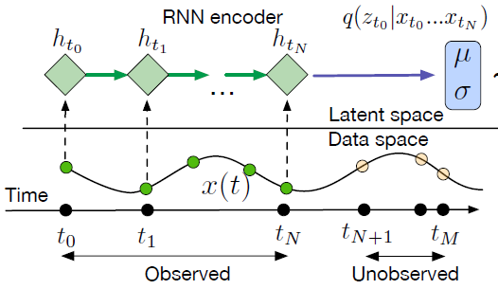
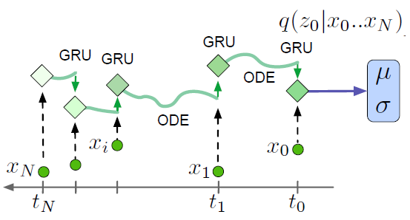

Latent ODE with an ODE-RNN encoder
~
To make predictions in this model, the ODE-RNN encoder is run backwards in time to produce an approximate posterior over the initial state:
Chen, et al., (2018) Neural Ordinary Differential Equations, NeurIPS.
Rubanova, et al., (2019) Latent ordinary differential equations for irregularly-sampled time series, NeurIPS

Slide 17
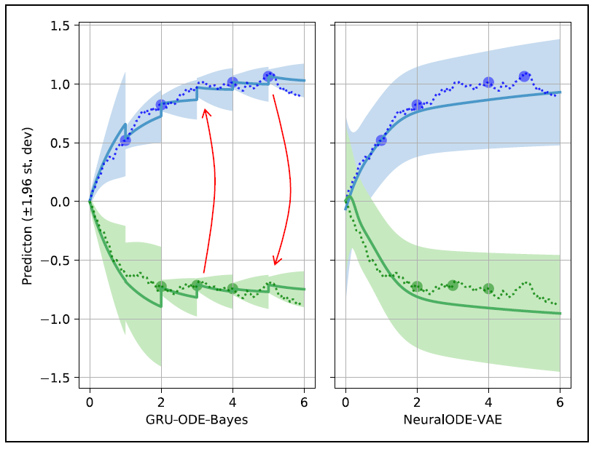
Combining GRU and ODE [De Brower et al. 2019]
GRU-ODE-Bayes vs NeuralODE-VAE
Process= 2D Ornstein-Uhlenbeck process with highly correlated Wiener processes (⇢ = 0.99).
Dotted lines = the underlying process of sporadic observations.
Solid lines = inferred means.
Shaded area = 95% confidence intervals.
Advantages:
smaller errors and smaller variance of GRU-ODE-Bayes vs. NeuralODE-VAE.
GRU-ODE-Bayes can infer that a jump in one variable also implies a jump in the other unobserved one (red arrows).
it also learns the reduction of variance resulting from a new incoming observation.
De Brower, et al., 2019, Gru-ode-bayes: Continuous modeling of sporadically-observed time series, NeurIPS

Slide 18
Brief history
Dynamical Systems: Lagaris, et al., (1998). Artificial neural networks for solving ordinary and partial differential equations. IEEE transactions on neural networks, 9(5):987–1000.
Residual Networks and Dynamical Systems:
Weinan, E., (2017). A proposal on machine learning via dynamical systems.
Lu, Y., et al., (2017). Beyond finite layer neural networks: Bridging deep architectures and numerical differential equations.
Ruthotto, L. and Haber, E., (2019). Deep neural networks motivated by partial differential equations.
Avelin, B. and Nyström, K., (2019). Neural odes as the deep limit of resnets with constant weights..
Stochastic Differential Equations: Li, et al., (2020). Scalable gradients for stochastic differential equations.
Latent Models: Rubanova, et al. (2019). Latent ordinary differential equations for irregularly-sampled time series.
Graph Neural Differential Equations (GNE):
Xhonneux, et al., (2019). Continuous graph neural networks.
Zhuang, et al., (2020). Ordinary differential equations on graph networks.
Poli, et al., (2020). Graph Neural Ordinary Differential Equations.

Slide 19
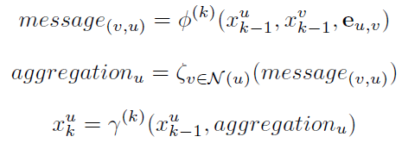



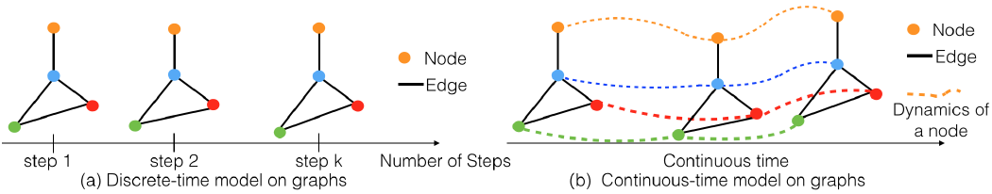
ODEs on graph networks [Zhuang et al. 2020]
Substitutes the f by the message-passing
Laplacian for the Continuous Model
All eigenvalues of the ODE are real and non-positive because the eigenvalues of the symmetrically normalized Laplacian are real and non-negative.
The hidden states of each node evolves continuously in time
Zhuang, et al. 2020, Ordinary differential equations on graph networks, ICLR
Notes:
function phi is parameterized by a neural network

Slide 20
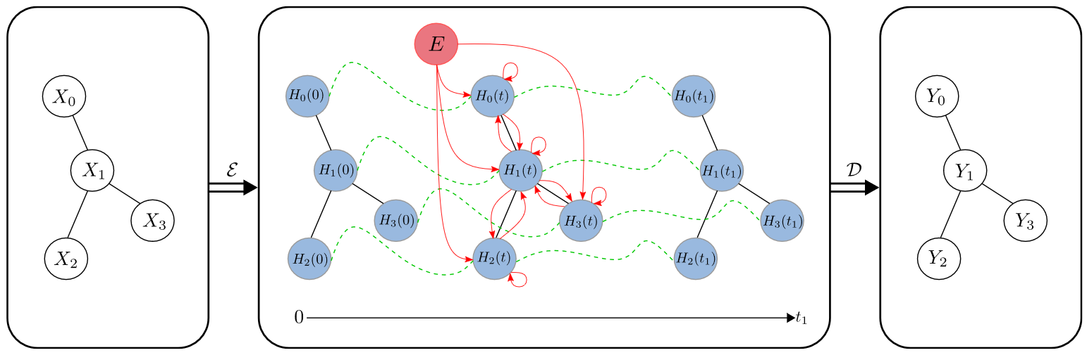
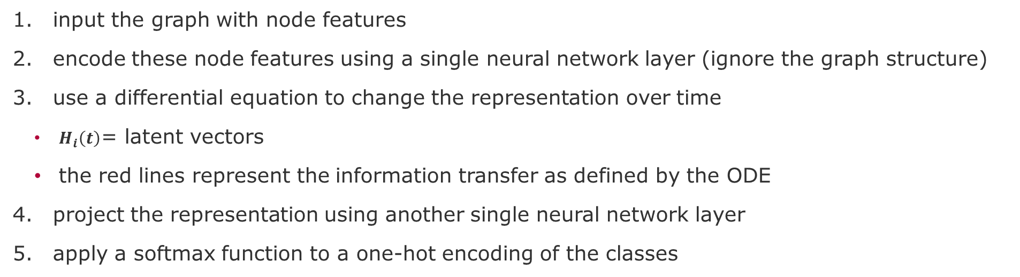
Continuous Graph Neural Networks [Xhonneux, et al. 2019]
input the graph with node features
encode these node features using a single neural network layer (ignore the graph structure)
use a differential equation to change the representation over time
$H_{i}\left(t\right)$= latent vectors
the red lines represent the information transfer as defined by the ODE
project the representation using another single neural network layer
apply a softmax function to a one-hot encoding of the classes
Xhonneux, et al., (2019). Continuous graph neural networks.

Slide 21
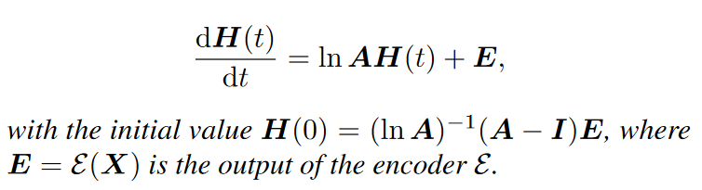


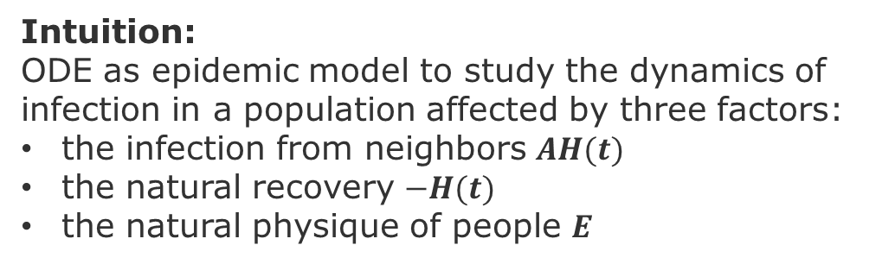
Continuous Graph Neural Networks [Xhonneux, et al. 2019]
How to update the features with time?
Because ln is intractable, we need to rely on a Taylor expansion
with the initial value being $H(0) =E$
Intuition:
ODE as epidemic model to study the dynamics of infection in a population affected by three factors:
the infection from neighbors $AH(t)$
the natural recovery $−H(t)$
the natural physique of people $E$

Slide 22

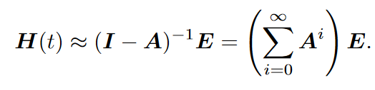
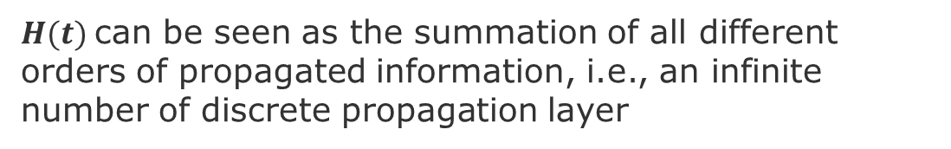
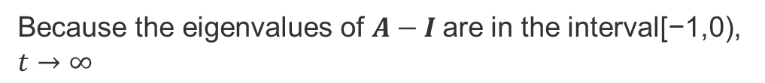
Analytical Solution of the ODE
Because the eigenvalues of $A−I$are in the interval[−1,0), $t→∞$
for large enough t we can approximate $H\left(t\right)$ as
$H(t)$can be seen as the summation of all different orders of propagated information, i.e., an infinite number of discrete propagation layer

Slide 23


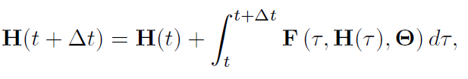
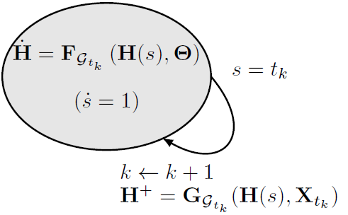
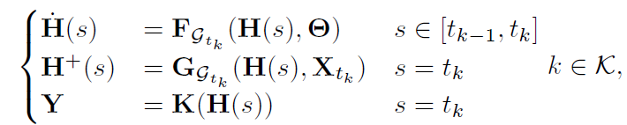
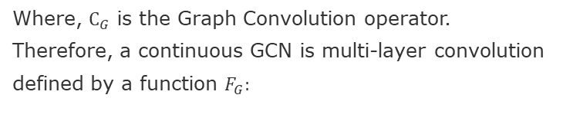
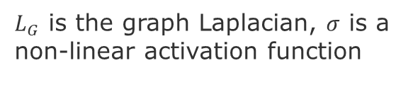
Taxonomy of Graph Neural Ordinary Differential Equations [Poli et al. 2020]
Graph convolution differential equations
Where, $C_{G}$ is the Graph Convolution operator.
Therefore, a continuous GCN is multi-layer convolution
defined by a function $F_{G}:$
$L_{G}$ is the graph Laplacian, $σ$ is a non-linear activation function
GDE smoothly steers the latent node features between two time instants
apply some discrete operator which produces a “jump” of H
H is processed by an output layer.
Spatio–Temporal Models
(dynamical system)
The solutions of these models are also called hybrid arcs see [1][2] on slides nodes
Autoregressive as Hybrid Automata
Autoregressive GDEs
Poli, et al., (2020). Graph Neural Ordinary Differential Equations.
Notes:
[1] A. J. Van Der Schaft and J. M. Schumacher. An introduction to hybrid dynamical systems, volume
251. Springer London, 2000.
[2] R. Goebel, R. G. Sanfelice, and A. R. Teel. Hybrid dynamical systems. IEEE Control Systems
Magazine, 29(2):28–93, 2009.

Slide 24
Next and Future Tasks
Compute and compare graph metrics (Wednesday, 2.12)
First draft of abstract (Friday, 4.12)
Predictions using traditional method (Wednesday, 9.12)
Related work draft (Friday, 11.12)
Node and Graph Feature Learning (Wednesday, 16.12)
Design alternative pipelines for your GNN
Three alternative with different options for embedding, aggregation, and encoding
Test at least one.
Execute pipeline for different configurations
Sensitivity Analysis
Ablation study

Slide 25
END

